Slide 1
Writing of Abstract by
Ir. Dr. Mokhtar Harun
4 Mar 2024

Slide 2
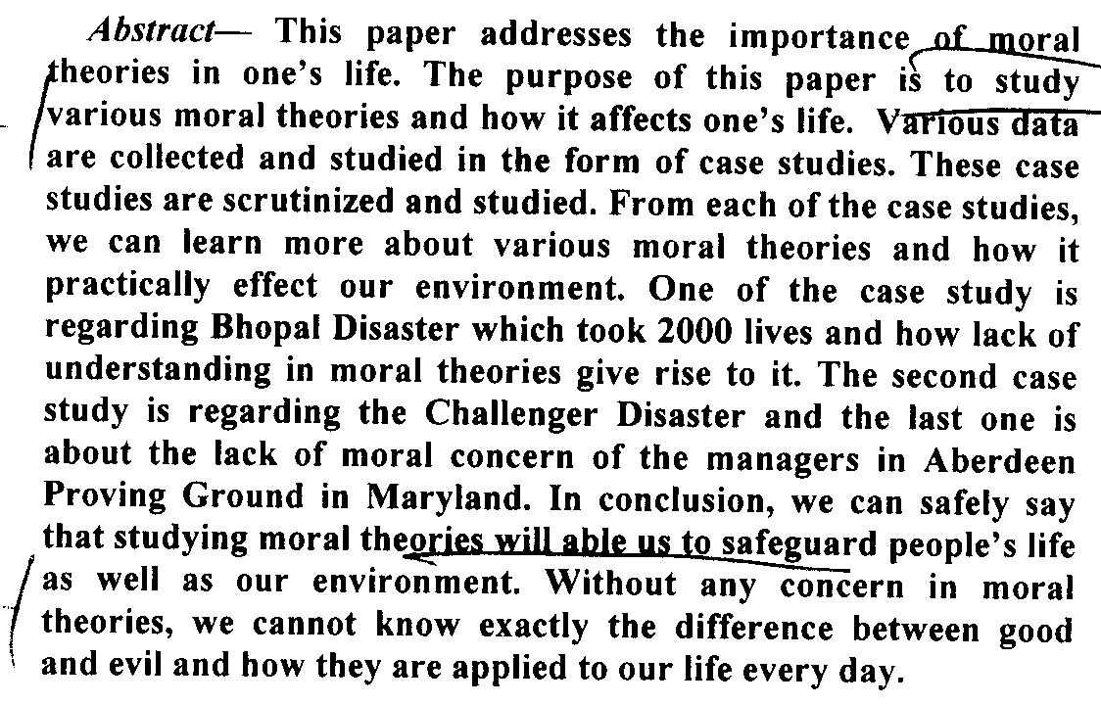
A sample of bad abstract from GP report entitled
“Moral Theories”

Slide 3
Moral Theories
Background
(Suggestion: 2 to 3 sentences)
- Not enough ideas to be researched on
- 2 more sentences would be helpful

Slide 4
Moral Theories
Purpose
(Suggestion: 1 sentence only)
Even if the researcher works for more than one outcomes
- The purpose “to study” shows no research work had been conducted, indicates no meaningful findings

Slide 5
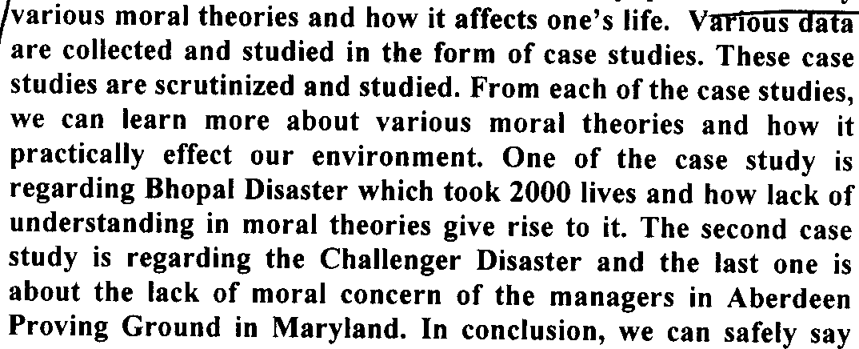
Moral Theories
Methodology
(Suggestion: 3 to 4 sentences)
- Ok, stating that case studies were used
- Since the purpose had not been properly defined, case studies presented seem irrelevant, and unsupportive

Slide 6
Moral Theories
Result
(Suggestion: 2-3 sentences)
- No result of research had been presented

Slide 7
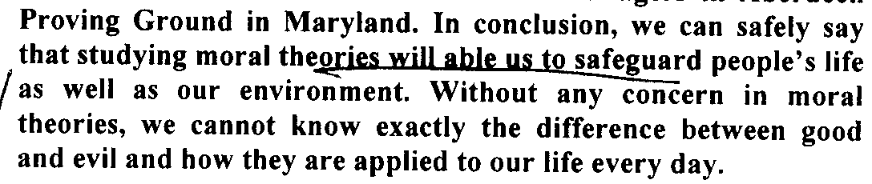
Moral Theories
Conclusion
(Suggestion: 1-2 sentences)
Conclusion here is just general opinion.
No conclusion from the research was made
In short, no finding reported

Slide 8
So how acceptable abstract looks like?

Slide 9
Good Abstract
The Reasons of People Do Not Wear Helmet When Riding Motorcycle
Abstract — Anyone who decides to ride a motorcycle must consider that wearing of helmets is the most effective strategy for preventing injuries from a crash or fall. It is very evident that riders is very vulnerable in crashing or falling even how knowledgeable and alert a rider he is. This research was conducted to investigate reason of students do not wear helmet when riding motorcycle. The respondents for this research are taken 20 students at college K9 café’s parking with not wear a helmet. A set of questionnaire was designed to gain primary data from the respondents about their reason, suggestion and others. To analysis this data, we used graph and pie chart method to easy analysis data from the questionnaire. It is found that 70% respondents were riding motorcycle without helmet. The main reason for not wearing helmet among male students were haste to get to the destination, and inconveniency for the women

Slide 10
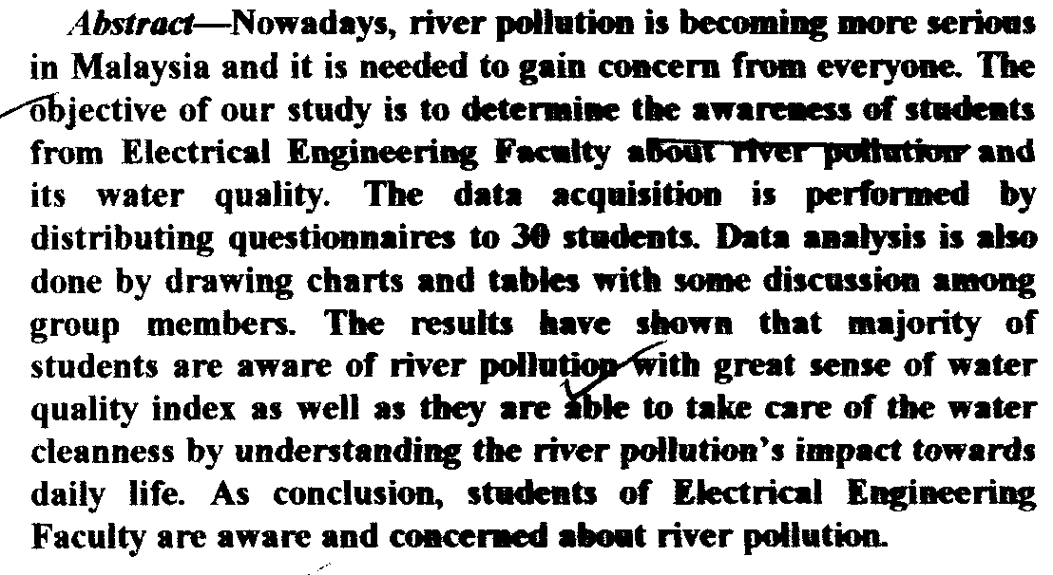
Good Abstract
Study Of Awareness About River Pollution Among FKE Students

Slide 11
Good Abstract
Study Of Awareness About River Pollution Among FKE Students

Slide 12
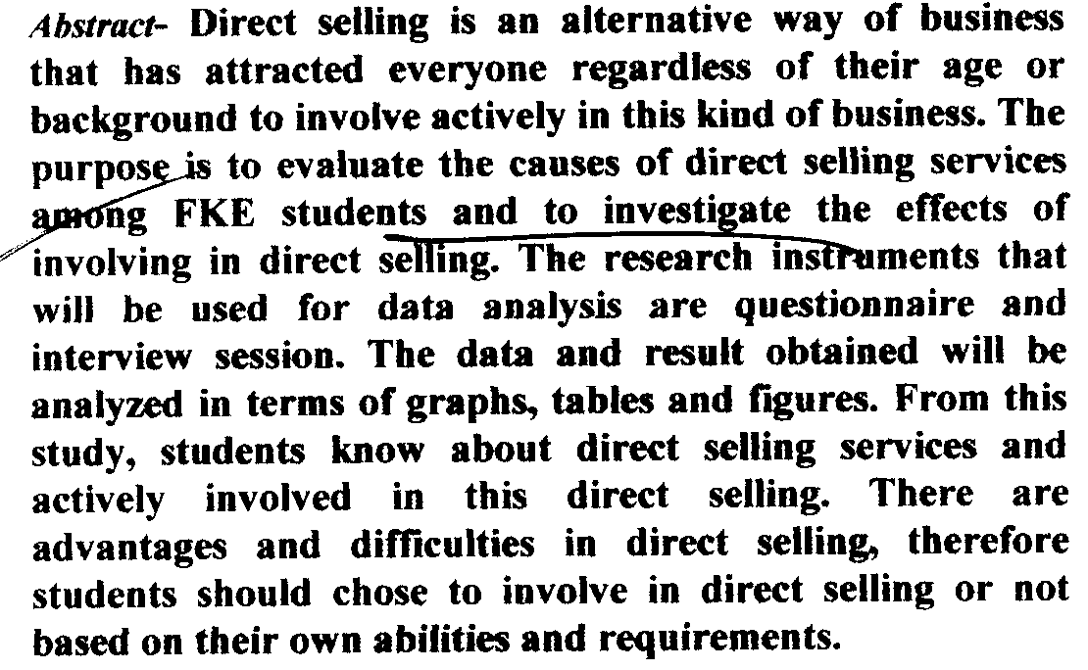
Good Abstract
Direct Selling

Slide 13
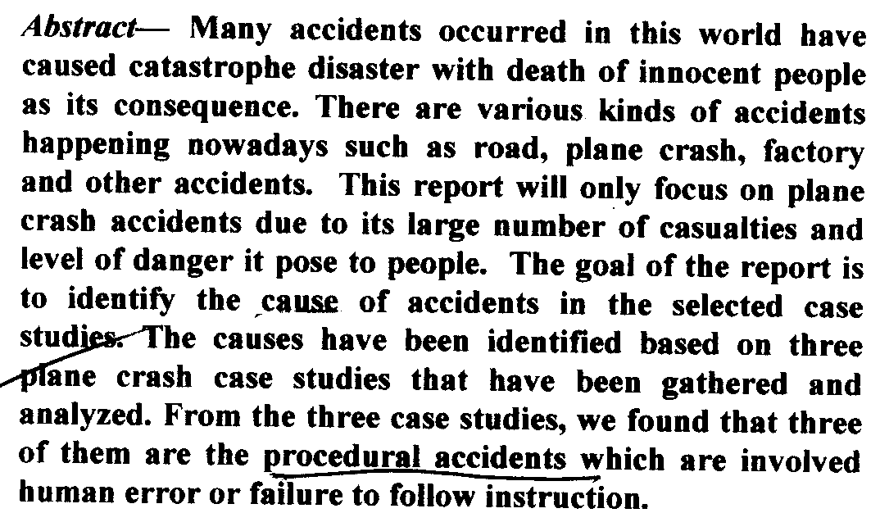
Good Abstract
The Definitions And Factors Affecting Accidents And Risks

Slide 14
Thank you

